Slide 1
Unit 5: Database Administration and Security

Slide 2
Database Administration Function
The advent of the DBMS and its shared view of data produced a new level of data management sophistication and led to the DP department to evolve into an information systems (IS) department. The responsibilities of the IS department were broadened to include:
A service function to provide end users with active data management support.
A production function to provide end users with specific solutions for their information needs through integrated application or management information systems.

Slide 3
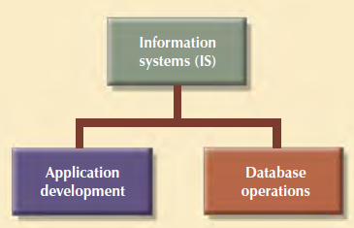
Database Administration Function
IS Internal Organization
The application development segment was in charge of gathering database requirements and logical database design, whereas
The database operations segment took charge of implementing, monitoring, and controlling the DBMS operations.

Slide 4
Database Administration Function
As the number of database applications grew, data management became an increasingly complex job, thus leading to the development of the database administration function.
The person responsible for the control of the centralized and shared database became known as the database administrator (DBA).
The DBA function in a line position has both the responsibility and the authority to plan, define, implement, and enforce the policies, standards, and procedures used in the data administration activity.
The DBA function in a staff position often creates a consulting environment in which DBA is able to devise the data administration strategy but does not have the authority to enforce it.

Slide 5
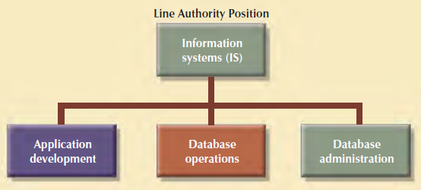
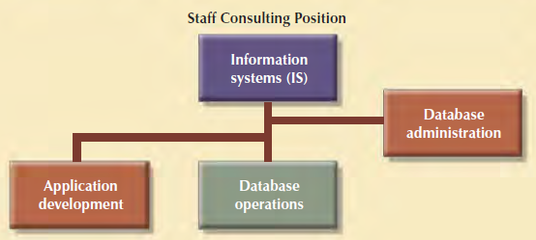
Database Administration Function
Line Authority Position
Staff Consulting Position

Slide 6
Database Administration Function
It is common practice to define the DBA function by dividing the DBA operations according to the Database Life Cycle (DBLC) phases.
The DBA function requires personnel to cover the following activities:
Database planning, including the definition of standards, procedures, and enforcement.
Database requirements gathering and conceptual design.
Database logical and transaction design.
Database physical design and implementation.
Database testing and debugging.

Slide 7
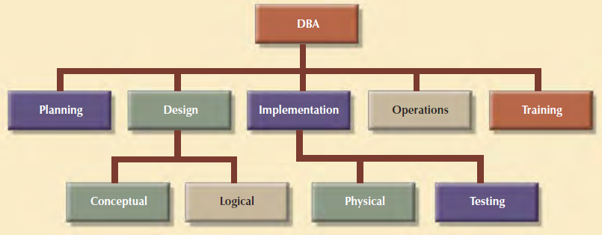
Database Administration Function
Database operations and maintenance, including installation, conversion, and migration.
Database training and support.
Data quality monitoring and management.

Slide 8
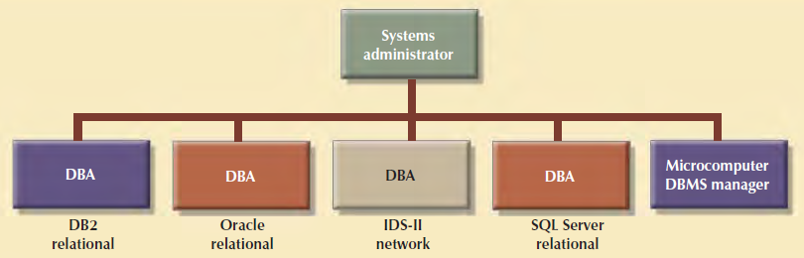
Database Administration Function
A company might have several different and incompatible DBMSs installed to support different operations.
The general coordinator of all DBAs is sometimes known as the systems administrator.

Slide 9
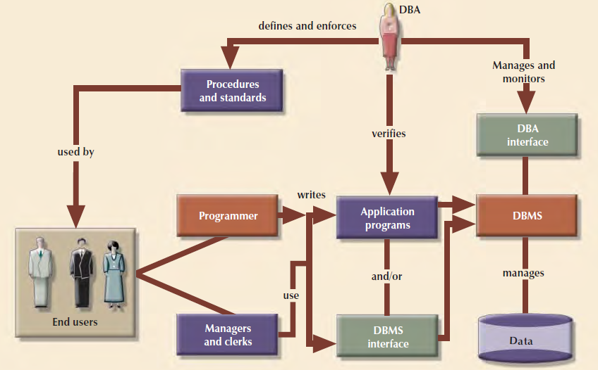
Summary of DBA Activities

Slide 10
Summary of DBA Activities
DBA is the focal point for data/user interaction .
The DBA defines and enforces the procedure and standard to be used by programmers and end users during their work with the DBMS.
The DBA also verifies that programmer and end user access meets the required quality and security standards.

Slide 11
Database Administration Tools
Following are the two tools used for Database Administration
Data Dictionary
Computer-Aided Software Engineering (CASE)

Slide 12
The Data Dictionary
The DBMS data dictionary provides the DBMS with its self-describing characteristic. In effect, the data dictionary resembles an X-ray of the company’s entire data set, and it is a crucial element in data administration.
Two main types of data dictionaries exist: 1. Integrated 2. Standalone
An integrated data dictionary is included with the DBMS. For example, all relational DBMSs include a built-in data dictionary or system catalog that is frequently accessed and updated by the RDBMS. Other DBMSs, especially older types, do not have a built-in data dictionary; instead, the DBA may use third-party standalone data dictionary systems.

Slide 13
The Data Dictionary
Data dictionaries can also be classified as active or passive. An active data dictionary is automatically updated by the DBMS with every database access, thereby keeping its access information up to date.
A passive data dictionary is not updated automatically and usually requires running a batch process.
Data dictionary access information is normally used by the DBMS for query optimization purposes.

Slide 14
The Data Dictionary
The data dictionary’s main function is to store the description of all objects that interact with the database.
Integrated data dictionaries tend to limit their metadata to the data managed by the DBMS.
Standalone data dictionary systems are usually more flexible and allow the DBA to describe and manage all of the organization’s data, whether or not they are computerized.

Slide 15
The Data Dictionary
How a Data Dictionary is used to derive the information
SYSTABLES stores one row for each table or view.
SYSCOLUMNS stores one row for each column of each table or view.
SYSTABAUTH stores one row for each authorization given to a user for a table or view in a database.

Slide 16


The Data Dictionary
Examples of Data Dictionary Usage

Slide 17


The Data Dictionary

Slide 18
CASE - computer-aided systems engineering
A CASE tool provides an automated framework for the Systems Development Life Cycle (SDLC). CASE uses structured methodologies and powerful graphical interfaces.
CASE tools are usually classified according to the extent of support they provide for the SDLC.
For example, front-end CASE tools provide support for the planning, analysis, and design phases; back-end CASE tools provide support for the coding and implementation phases.

Slide 19
CASE - computer-aided systems engineering
The benefits associated with CASE tools include:
A reduction in development time and costs.
Automation of the SDLC.
Standardization of systems development methodologies.
Easier maintenance of application systems developed with CASE tools.
One of the CASE tools’ most important components is an extensive data dictionary, which keeps track of all objects created by the systems designer.

Slide 20
CASE - computer-aided systems engineering
For example, the CASE data dictionary stores data flow diagrams, structure charts, descriptions of all external and internal entities, data stores, data items, report formats, and screen formats.
A CASE data dictionary also describes the relationships among the components of the system.
Several CASE tools provide interfaces that interact with the DBMS. Those interfaces allow the CASE tool to store its data dictionary information by using the DBMS.

Slide 21
CASE - computer-aided systems engineering
In a CASE development environment, the database and application designers use the CASE tool to store the description of the database schema, data elements, application processes, screens, reports, and other data relevant to the development process.
The CASE tool integrates all systems development information in a common repository, which can be checked by the DBA for consistency and accuracy.
As an additional benefit, a CASE environment tends to improve the extent and quality of communication among the DBA, the application designers, and the end users.

Slide 22
CASE - computer-aided systems engineering
A typical CASE tool provides five components:
Graphics designed to produce structured diagrams such as data flow diagrams, ER diagrams, class diagrams, and object diagrams.
Screen painters and report generators to produce the information system’s input/output formats (for example, the end-user interface).
An integrated repository for storing and cross-referencing the system design data. This repository includes a comprehensive data dictionary.
An analysis segment to provide a fully automated check on system consistency, syntax, and completeness.
A program documentation generator.
Below fig illustrate how Microsoft Visio Professional can be used to produce an ER Diagram.An example of a CASE tool: Microsoft Visio Professional

Slide 23
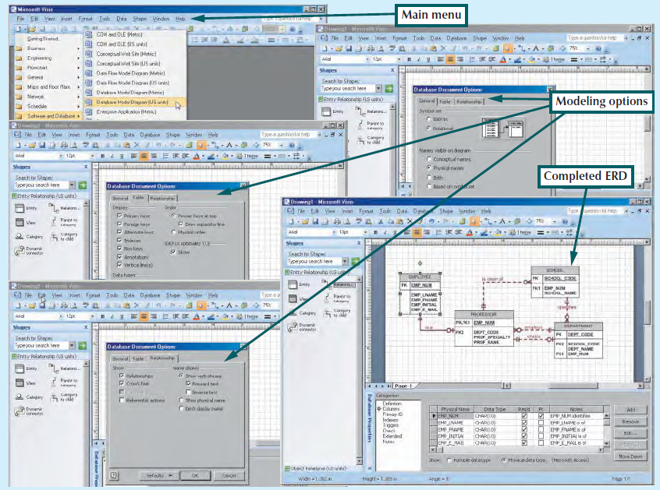

Slide 24
Database Security
Security refers to activities and measures to ensure the confidentiality, integrity, and availability of an information system and its main asset, data.
To understand the scope of data security, let’s discuss each of the three security goals in more detail:
Confidentiality
Deals with ensuring that data is protected against unauthorized access, and if the data are accessed by an authorized user, that the data are used only for an authorized purpose.
The data security officer spends a great amount of time ensuring that the organization is in compliance with the desired levels of confidentiality. Compliance refers to activities undertaken to meet data privacy and security reporting guidelines.

Slide 25
Database Security
Integrity
Within the data security framework, is concerned with keeping data consistent, free of errors, or anomalies.
From the security point of view, integrity deals not only with the data in the database but also with ensuring that organizational processes, users, and usage patterns maintain such integrity.
For example, a work-at-home employee using the Internet to access product costing could be considered an acceptable use. security standards might require the employee to use a secure connection and follow strict procedures to manage the data at home.

Slide 26
Database Security
Availability
Refers to the accessibility of data whenever required by authorized users and for authorized purposes.
To ensure data availability, the entire system must be protected from service degradation or interruption caused by any source (internal or external).
Service interruptions could be very costly for companies and users alike. System availability is an important goal of security.

Slide 27
Security Policies
The tasks of securing the system and its main asset, the data, are performed by the database security officer and the database administrator(s), who work together to establish a cohesive data security strategy.
Such security strategy begins with defining a sound and comprehensive security policy.
A security policy is a collection of standards, policies, and procedures created to guarantee the security of a system and ensure auditing and compliance.
The security audit process starts by identifying the security vulnerabilities in the organization’s information system infrastructure and identifying measures to protect the system and data against those vulnerabilities.

Slide 28
Security Vulnerabilities & Measures
A security vulnerability is a weakness in a system component that could be exploited to allow unauthorized access or cause service disruptions.
The nature of such vulnerabilities could be of multiple types:
Technical - Such as a flaw in the operating system or Web browser.
Managerial - For example, not educating users about critical security issues.
Cultural - Hiding passwords under the keyboard or not shredding confidential reports.
Procedural - Not requiring complex passwords or not checking user Ids.

Slide 29
Security Vulnerabilities & Measures
Whatever the case, when a security vulnerability is left unchecked, it could become a security threat.
A security threat is an imminent security violation that could occur at any time due to unchecked security vulnerability.
A security breach occurs when a security threat is exploited to negatively affect the integrity, confidentiality, or availability of the system.

Slide 30
Security Vulnerabilities & Measures
Security breaches can yield a database whose integrity is either preserved or corrupted:
Preserved: Action is required to avoid the repetition of similar security problems, but data recovery may not be necessary. As a matter of fact, most security violations are produced by unauthorized and unnoticed access for information purposes, but such snooping does not disrupt the database.
Corrupted: Action is required to avoid the repetition of similar security problems, and the database must be recovered to a consistent state. Corrupting security breaches include database access by computer viruses and by hackers whose actions are intended to destroy or alter data.

Slide 31
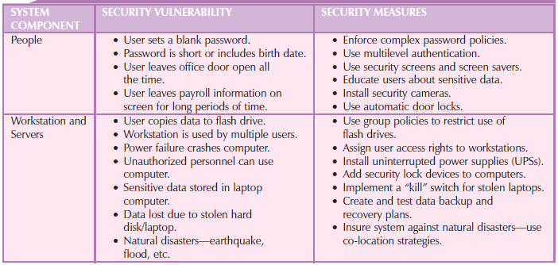
Security Vulnerabilities & Measures

Slide 32
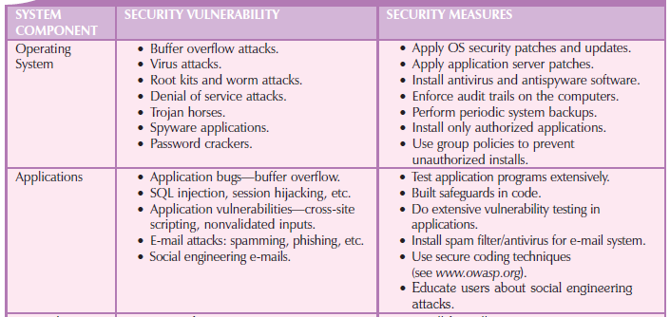
Security Vulnerabilities & Measures

Slide 33
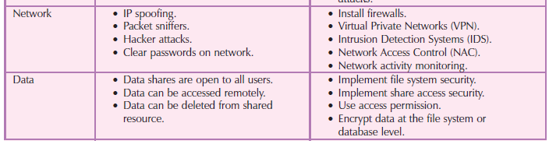
Security Vulnerabilities & Measures

Slide 34
The DBA at Work: Using Oracle for Database Administration
Technical tasks handled by the DBA in a specific DBMS:
Creating and expanding database storage structures
Managing database objects such as tables, indexes, triggers, and procedures
Managing end-user database environment
Customizing database initialization parameters
All DBMS vendors provide software tools and utilities to perform database administrative tasks

Slide 35
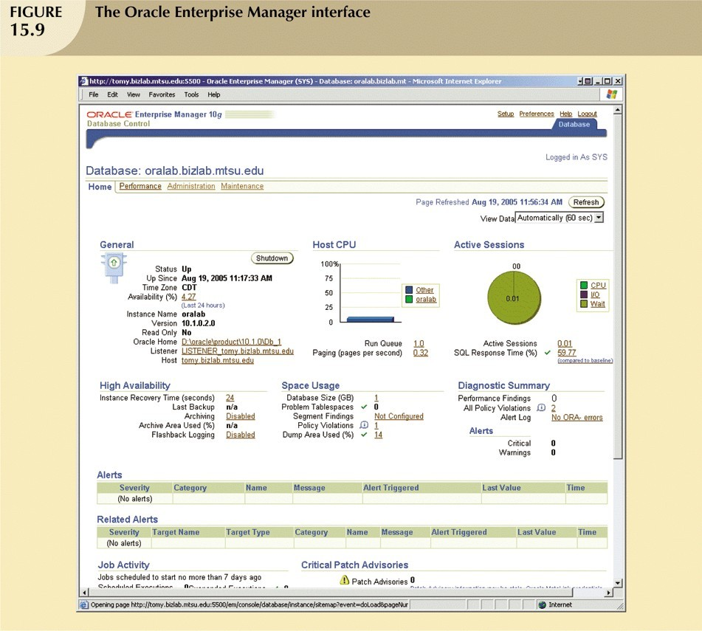
Oracle Database Administration Tools
All Database vendor supply a set of database administration tools.
In Oracle, most DBA tasks performed via Oracle Enterprise Manager interface

Slide 36
The Default Login
To perform administrative tasks,you must connect to the database using
– Username with administrative(DBA) privileges
By default oracle automatically creates SYSTEM and SYS user IDs that have administrative privileges with every new database you create.
You can define preferred credentials for each database by clicking on
Preferences link at the top of the page, then click on Preferred Credentials
Finally choose your target Username under Set Credentials and passwords are database specific

Slide 37
Ensuring an Automatic RDBMS Start
One of the basic DBA task is to ensures that your database access is automatically started when you turned on computer
Startup procedure will be different for each operating system.
You would need to identify the required services to ensure automatic database startup
Service is a Windows system name for a special program that runs automatically as part of the operating system
This program ensures the availability of required services to the system and to end user on local computer or over network.

Slide 38
Ensuring an Automatic RDBMS Start
Note the following Oracle services:
1.OcacleOraDb11g_home1TNSListener is the process that “listen to” and processes the end- user connection request over the network. For example when a SQL connection request ,such as “Connect userid/password@GRADORA”,is sent over network, the listener service will take the request,validate it, and establish the connection.
2.Oracle Service GRADORA refer to the oracle processes running in memory that are associated with the GRADORA database instance.
Database instance: As a separate location in memory reserved to run the database
May have several databases running in memory at the same time

Slide 39
Creating Tablespaces and Datafiles
Each DBMS manages data storage differently.
Database is logically composed of one or more tablespaces.
Tablespace is a logical storage space. Tablespaces are used primarily to group related data logically.
The Tablespace data are Physically stored in one or more datafiles.
Datafile physically stores the database’s data. Each datafile is associated with one and only one tablespace.
Each datafile can reside in a different directory on the hard disk
Database has 1:M relationship with tablespaces
Tablespace has 1:M relationship with datafiles

Slide 40
Creating Tablespaces and Datafiles
When the DBA creates a database, Oracle automatically creates the tablespace and datafile
The SYSTEM tablespace is used to store the data dictionary data.
The USERS tablespace is used to store the table data created by the end user.
The TEMP tablespace is used to store the temporary tables and indexes created during execution of SQL statements. For example temporary tables are created when your SQL statement contain an ORDER BY,GROUP BY, or HAVING clause.
The UNDOTBS1 tablespace is used to store database transaction recovery information. If for any reason a transaction must be rolled back, the UNDOTBS1 tablespace is used to store undo information.

Slide 41
Managing the Database Objects: Tables, Views, Triggers, and Procedures
Another important aspect of managing a database is monitoring the database objects that were created in the database.
The Oracle Enterprise Manager gives the DBA a graphical user interface to create,edit,view and delete database objects in the database.
A Database object is basically any object created by end users for example tables,views,indexes,stored procedure and triggers.
An Oracle Schema is a logical section of the database that belongs to a given user and that schema is identified by a username. For example, if the user named SYSTEM creates a VENDOR table, the table will belong to the SYSTEM schema. Within the schema, users create their own tables and other objects Normally, users authorized to access only the objects that belong to their own schemas

Slide 42
Managing Users and Establishing Security
One of the most common database administration activities is creating and managing database users.
The security section of the Oracle Enterprise Manager’s Administration page enables the DBA to create users,roles,and profiles.
A User is uniquely identifiable object that allows a given person to log on to the database
A Role is a named collection of database access privileges that authorizes a user to connect to the database and use system resources. Example of roles are as follows:

Slide 43
Managing Users and Establishing Security
-CONNECT allows a user to connect to the database and create and modify tables, views and other data-related objects
-RESOURCE allows a user to create triggers,procedures and other data management objects
-DBA gives the user database administration privileges.
A Profile is a named collection of setting that control how much of the database resource a given user can use.

Slide 44
Managing Users and Establishing Security
To create a new user,the DBA uses the Create Uswer page .
The General link allows the DBA to assign the name,profile and password to the new user.Also in this page,the DBA defines the default tablespace used to store table data and the temporary tablespace for temporary data.
The Roles link allows the DBA to assign roles for a user.
The Quotas link allows the DBA to specify the maximum amount of storage that the user can have in each assigned tablespace

Slide 45
Customizing the Database Initialization Parameters
Fine-tuning a database is another important DBA task.
This task usually require the modification of database configuration parameters
Some are changed in real time using SQL commands
Some parameter may affect database instance
While others affect entire RDBMS and all instance.
Each database has an associated database initialization file that stores it’s run time configuration parameters
One of the important function by initialization parameters is to reserve the resources used by the database at run time
Once you modify initialization parameters, may need to restart the database

Slide 46
Creating a New Database
General database creation format tends to be generic
Execution tends to be DBMS-specific
Leading RDBMS vendors offer option to create databases manually
Use SQL commands or GUI-based process
Oracle Database Configuration Assistant uses a wizard interface

Slide 47
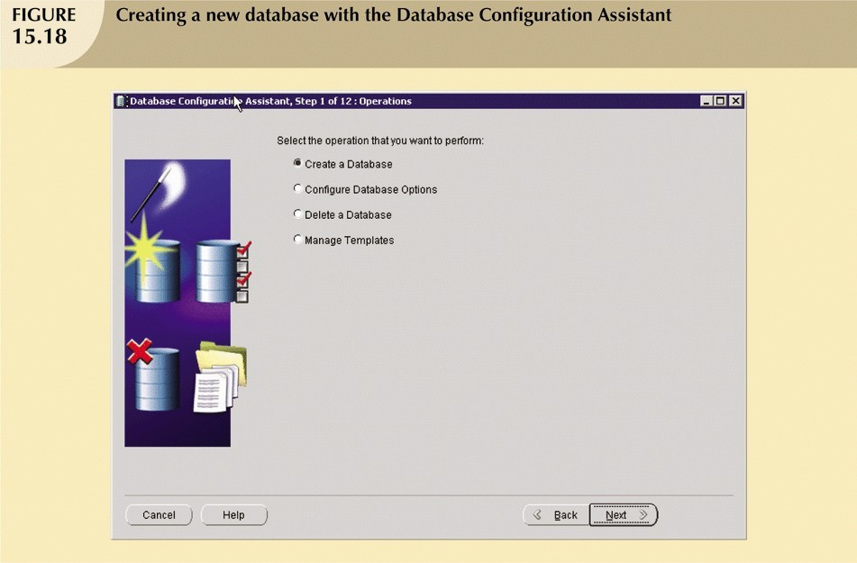

Slide 48
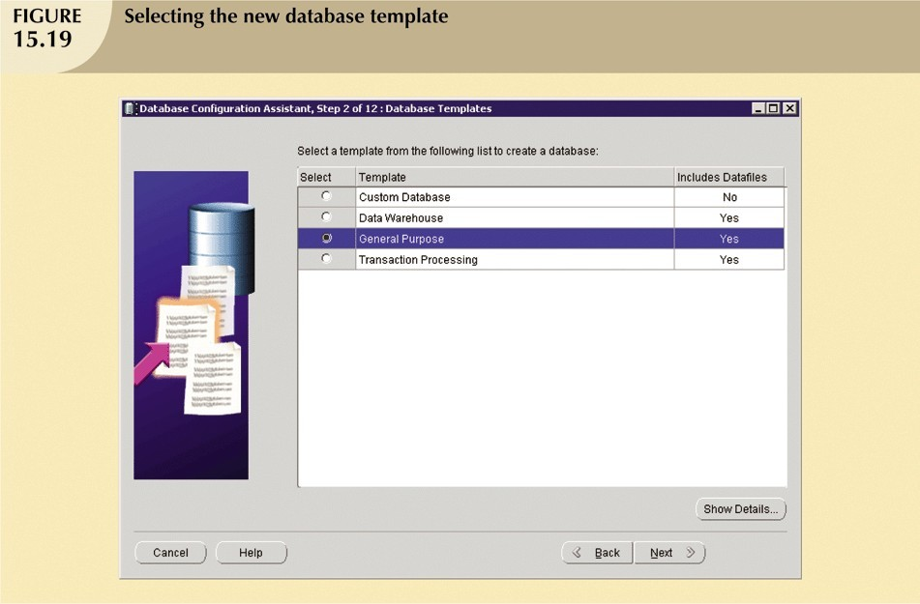

Slide 49
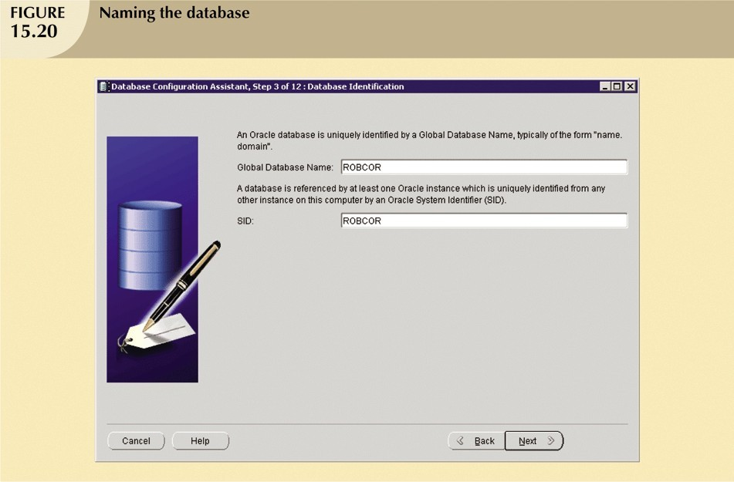

Slide 50
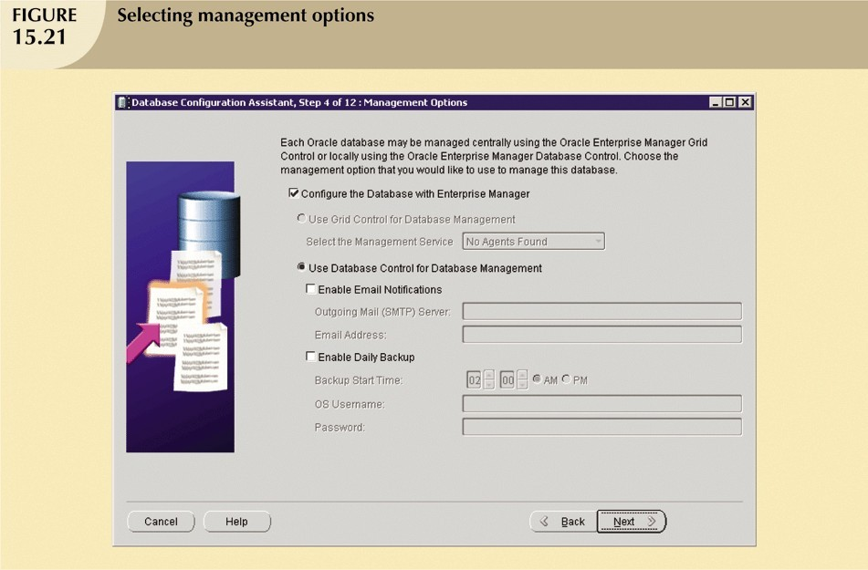

Slide 51
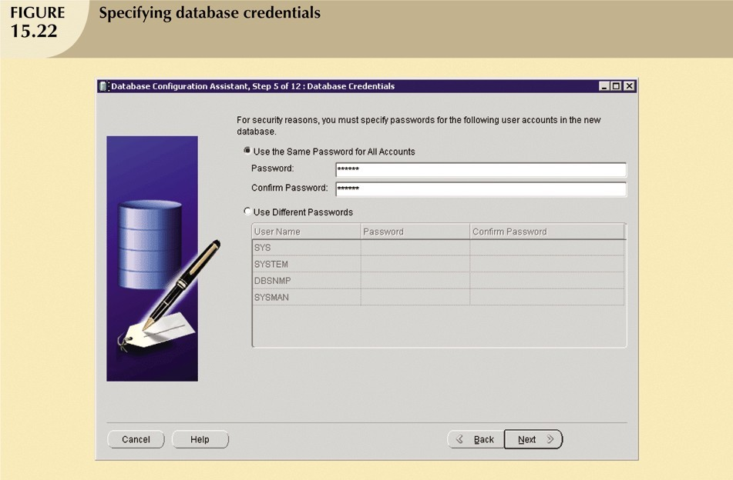

Slide 52
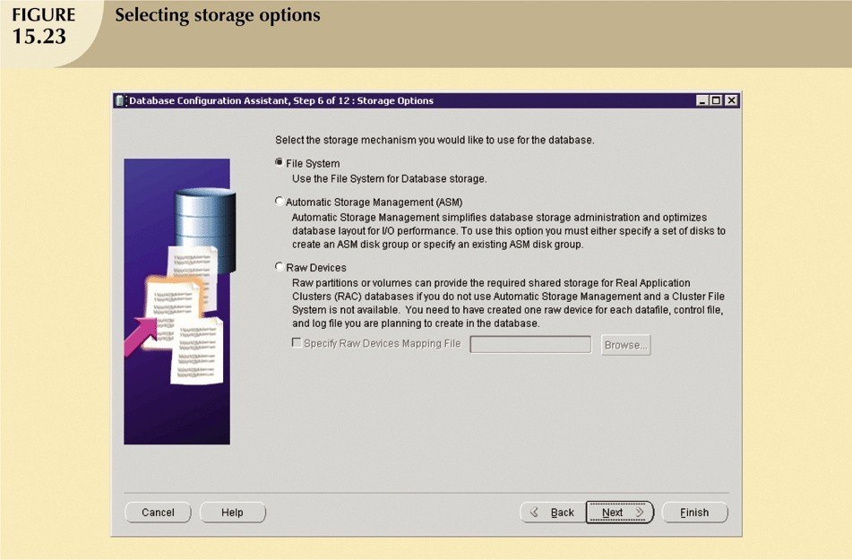

Slide 53
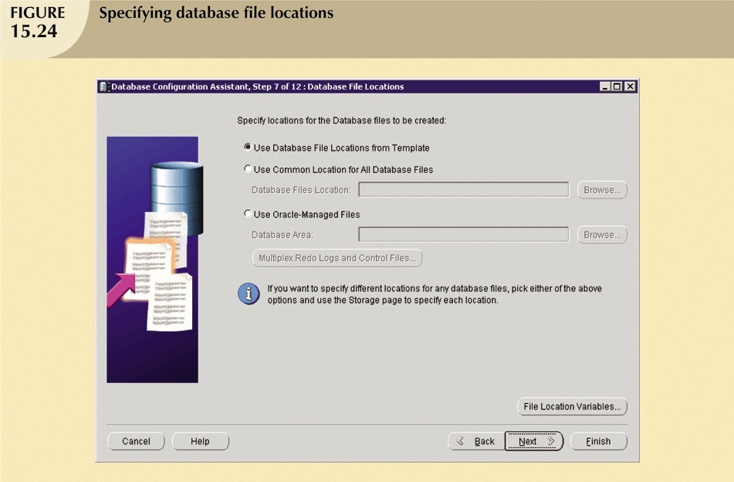

Slide 54
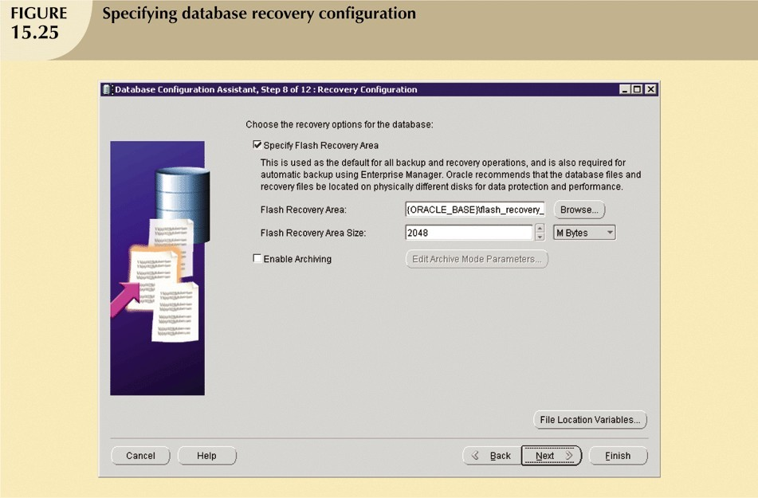

Slide 55
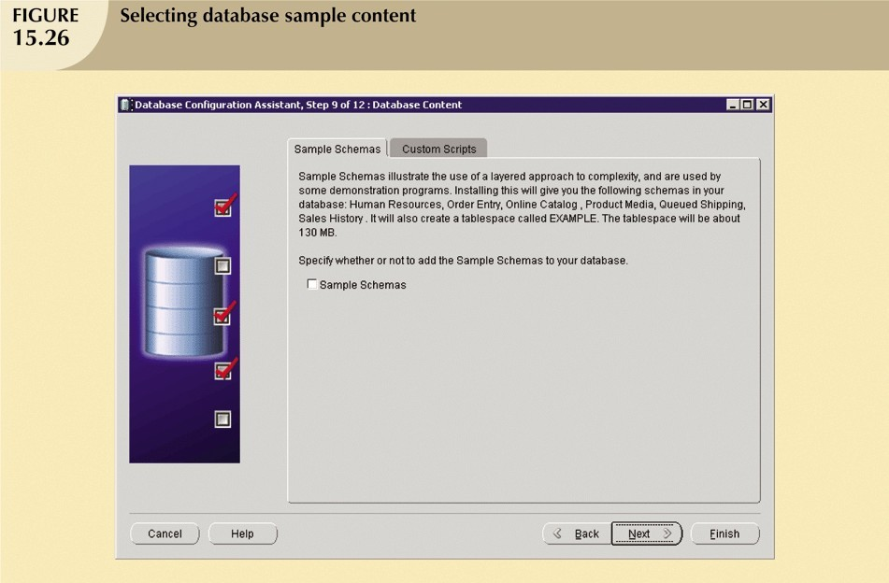

Slide 56
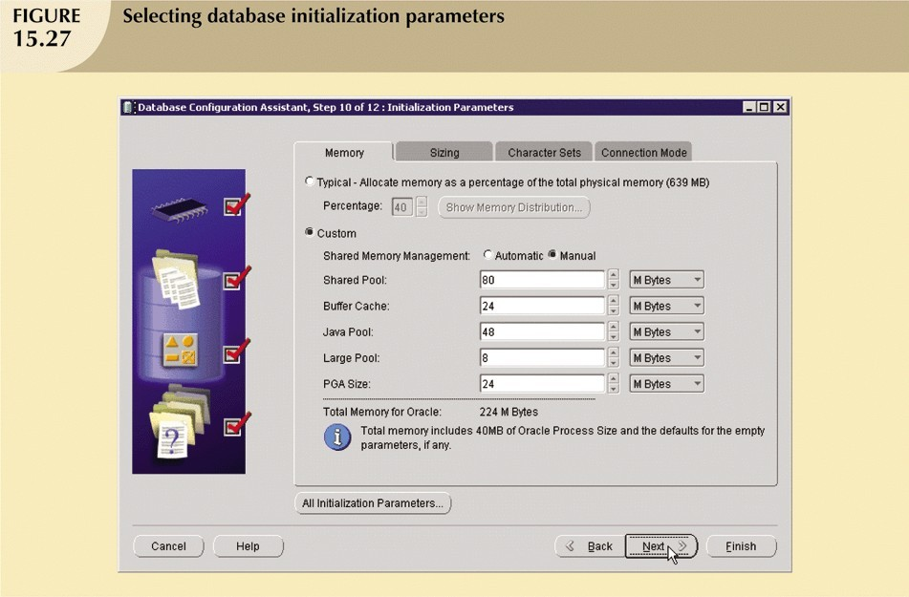

Slide 57
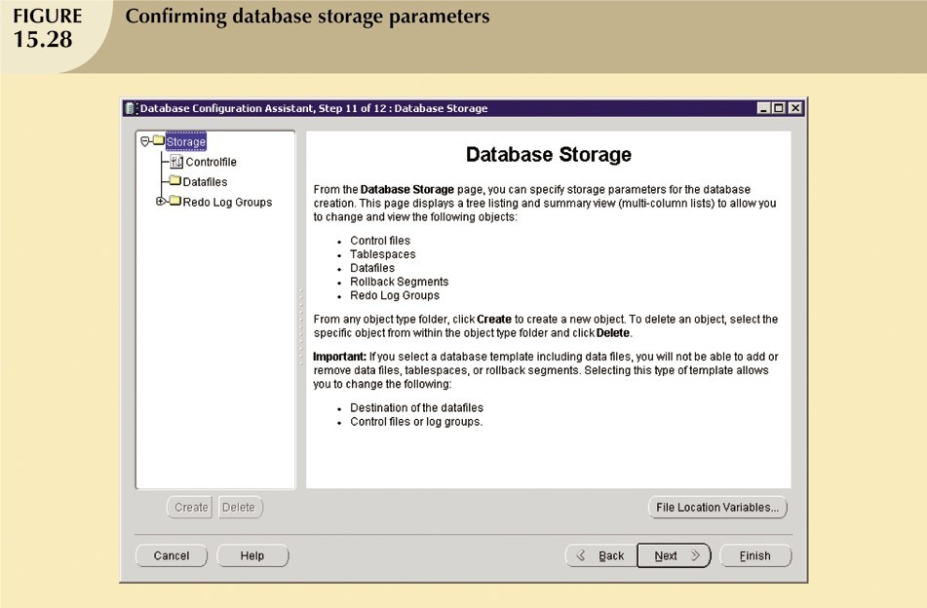

Slide 58
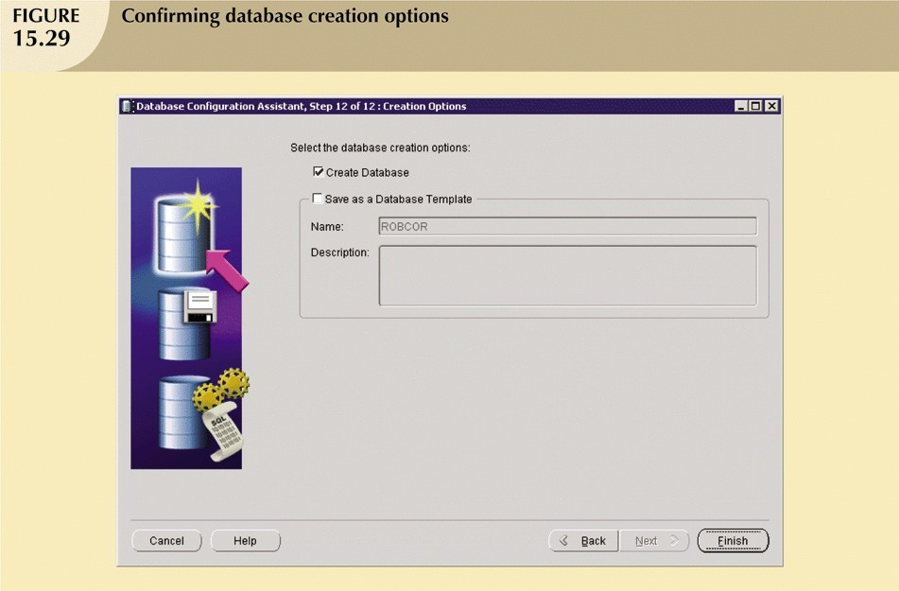

Slide 59
